Slide 1



Deploying real AzS HCI clusters with WSLab
WSLab is not only for labs
Jaromir Kaspar
Sr. Premier Field Engineer
@jaromirkaspar

Slide 2
Objectives
Learn what WSLab is
What WSLab Scenarios are
How to deploy real infrastructure

Slide 3

whoami /all /fo list
PFE@Microsoft
WSLab author (obviously)

Slide 4
Wslab /?
Bunch of scripts and scenarios hosted on GitHub
If you are using it, it must have changed your life

Slide 5
But it’s lab, isn’t it?
Yes, it’s a perfect lab!
But all scenarios can be reused for production!

Slide 6
Simple deployment of S2D
Start with S2D HCI scenario
https://github.com/microsoft/WSLab/tree/master/Scenarios/S2D%20Hyperconverged
follow Scenario.ps1
Prereqs: domain joined Servers, Admin WS (Win10 or Windows Server)
Admin Workstation
Domain Controller
S2D Infrastructure
…

Slide 7
Demo – Deploying HCI from Admin Workstation

Slide 8
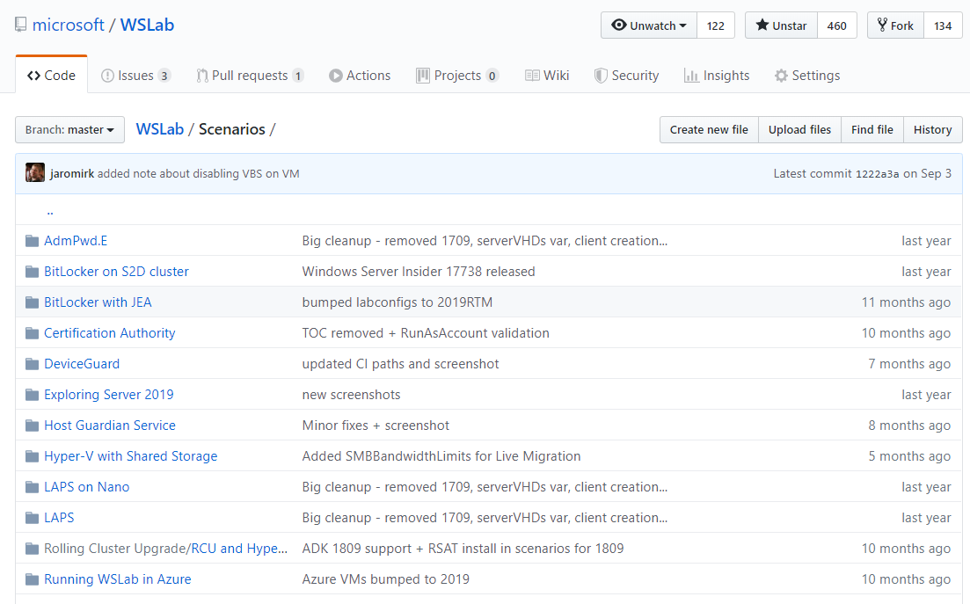
Takeaway
Super easy to deploy
Very easy to document – just save a copy of script
There is much more – over 50 scenarios!

Slide 9
Deployment of S2D from SCVMM
SCVMM and Bare Metal scenario
https://github.com/Microsoft/WSLab/tree/master/Scenarios/S2D%20and%20Bare%20Metal%20with%20SCVMM
Commented sections for real world deployments
Prereqs: domain joined Servers, Admin WS (Win10 or Windows Server), SCVMM
Admin Workstation
Domain Controller
SCVMM
S2D Infrastructure
…

Slide 10
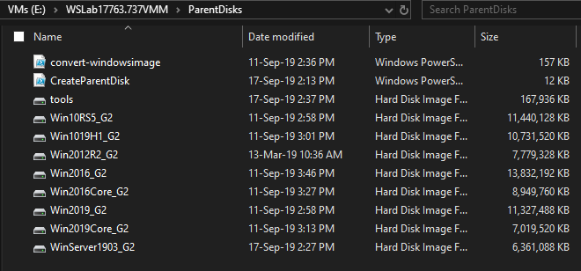
Deployment of S2D from SCVMM – cont.
Simulation covered at aka.ms/wslabvideos
VHD for OS can be created with CreateParentDisk.ps1

Slide 11
Demo

Slide 12
Deployment of S2D from Laptop – POC
Deploy WSLab with SCVMM (labconfig can customize domain, DHCP scope…)
After deployment can be DC moved to freshly deployed cluster
SCVMM can be deployed on separate VM (manual work)
Laptop with WSLab
WSLab-DC
Internal
Switch
External
Switch
Physical Switch
S2D Infrastructure
…

Slide 13
Closing

